Slide 1
A model of congruent and opposite neurons achieving multisensory integration
Xueyan Niu Julie
Notes:
Introducing Wenhao and Ho Yin

Slide 2
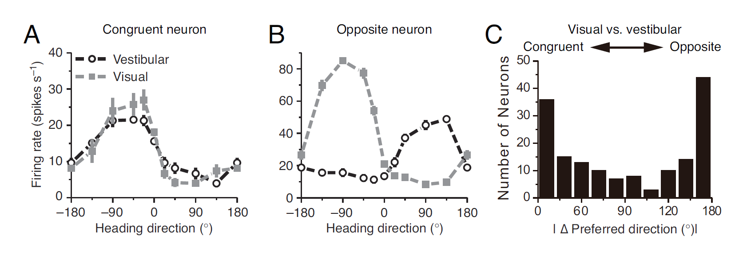
Multisensory integration
Receive cues from different modalities
Integrate (one source) or segregate them (multiple sources)
When judging heading direction, we rely on both visual and vestibular information
Question: What is the neural circuit that performs cue integration / segregation in this task?
Facts from experiment: congruent and opposite neurons found in MSTd (visual) and VIP (vestibular)
Notes:
MSTd: dorsal medial superior temporal area
VIP: ventral intraparietal area
Congruent neurons: prefer the same direction from two modalities
Opposite neurons: prefer the opposite direction from two modalities
Figure A, B: congruent and opposite neurons in MSTd, similar ones found in VIP
Figure C: same number of congruent and opposite neurons

Slide 3
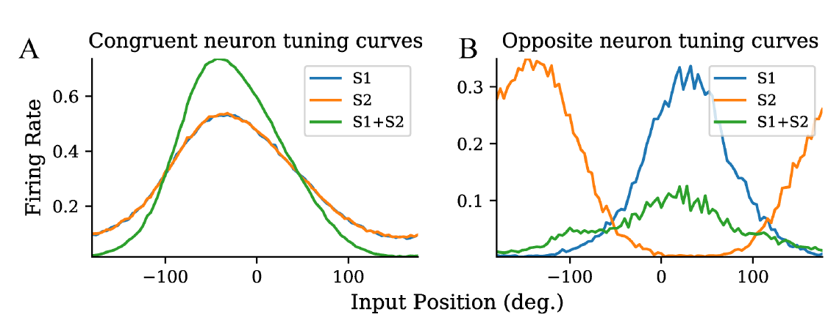
Logic of the model
Question: What is the neural circuit that performs cue integration / segregation?
Facts from experiment: congruent and opposite neurons found in both two uni-sensory brain areas
Our proposal: congruent neurons integrate the two cues; opposite neurons record the disparity of two cues

Slide 4
Model
Wrc
Wrc
WC1C2
C1
C2
r1
WC2C1
Wro
Wro
WC1O1
WC2O2
WS1C1
O1
WS2C1
O2
S1
S2
WS2O2
-pi
Stimulus 1
pi
WS1O1
Stimulus 1
Stimulus 2
N neurons in S1, C1, O1, S2, C2, O2:
(N, 1)
(N, 1)
(N, N)
(N, 1)

Slide 5
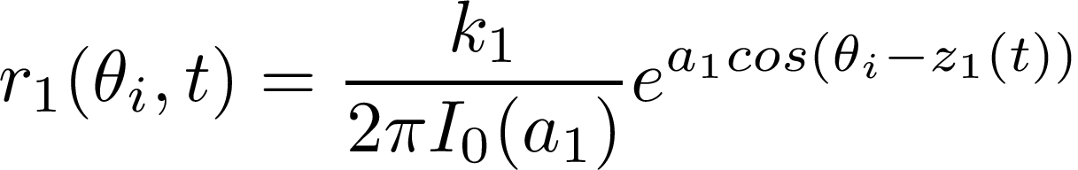


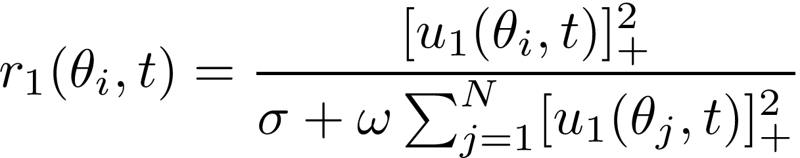
Model
N neurons in S1, C1, O1, S2, C2, O2:
(N, 1)
(N, 1)
(N, N)
(N, 1)
Input firing rate r_1(t) and r_2(t):
r1
: strength of input
-pi
Stimulus 1
pi
: concentration of input
N neurons
Firing rate of congruent and opposite neurons: by divisive normalization

Slide 6
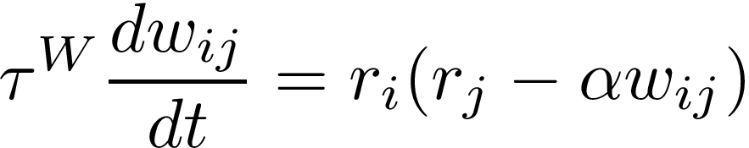
Training the weights
Wenhao et al. (2019) showed that by setting the weights to certain values, congruent neurons and opposite neurons can have the desired behavior
Can the weights be learnt by a biologically plausible way (Hebbian learning)?
If the weights trained are reasonable -> the proposed circuit is possible in brain
If the congruent and opposite neurons can perform right -> the proposed circuit is in accordance with experiments
Oja’s rule (a variation of Hebbian learning):
j
i

Slide 7
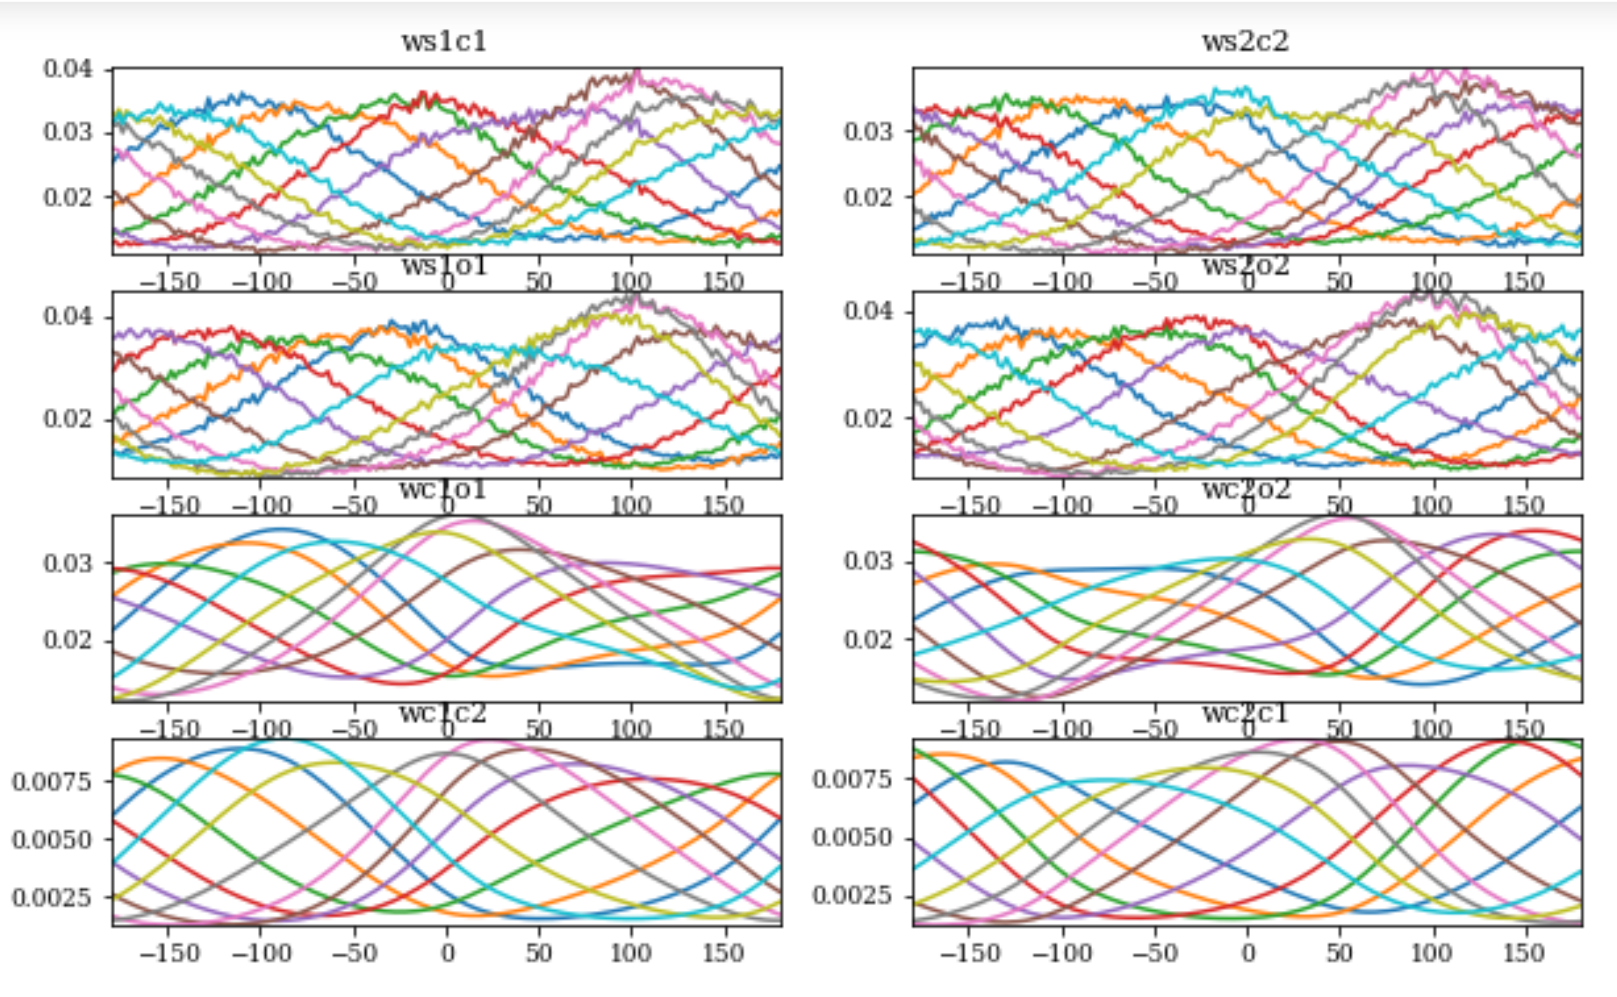
Results: weights
One color: the weight from one sending neuron to N receiving neurons that span [-pi, pi]
Weights follow von Mises (or Gaussian) distribution, same as in other modeling

Slide 8
Results: tuning curve

Slide 9
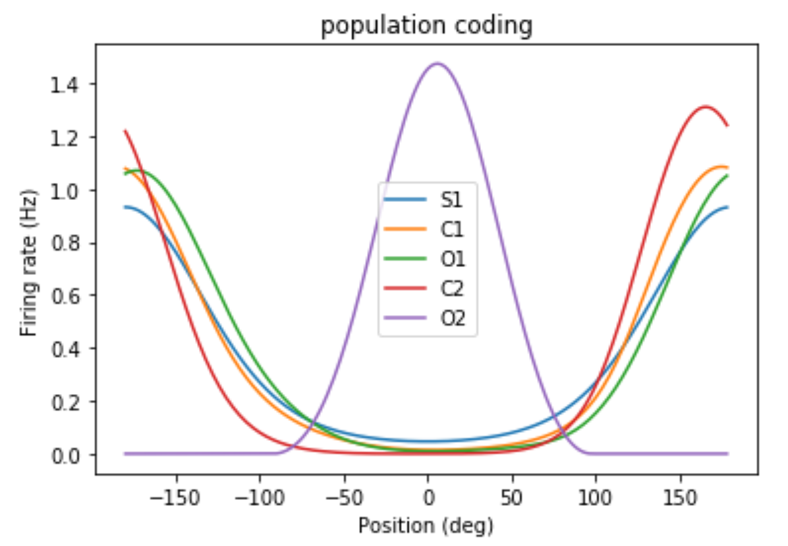
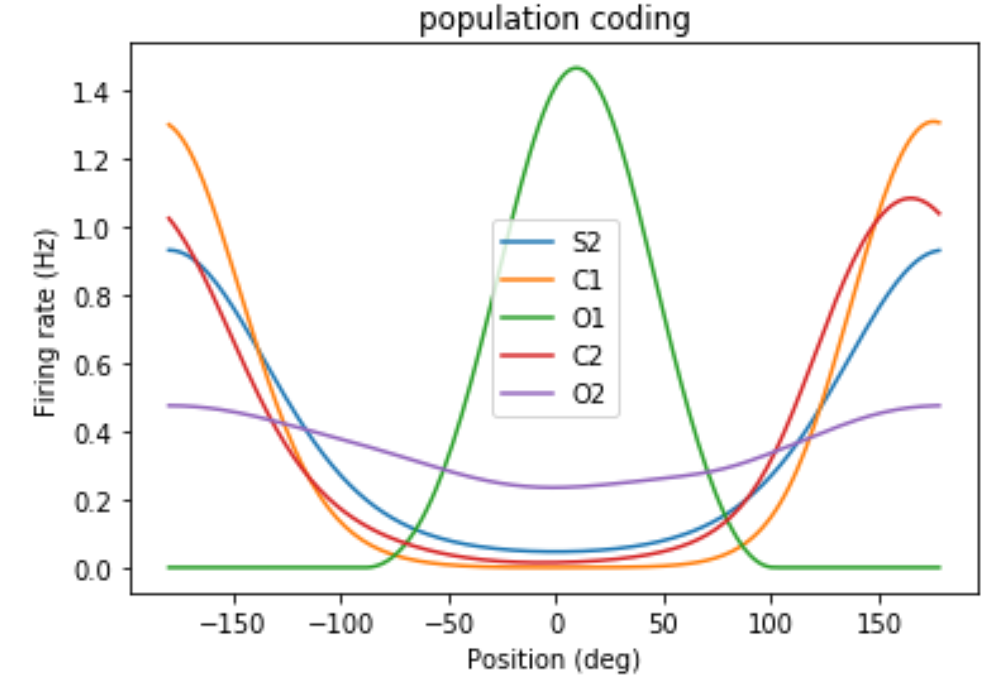
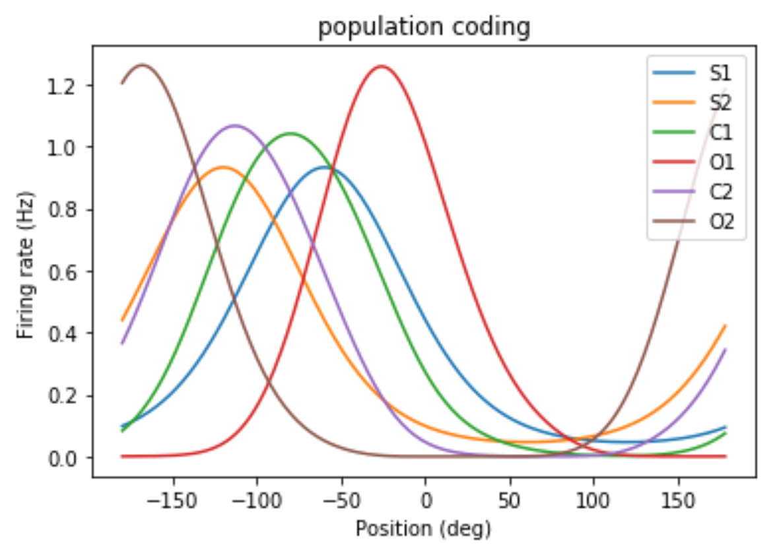
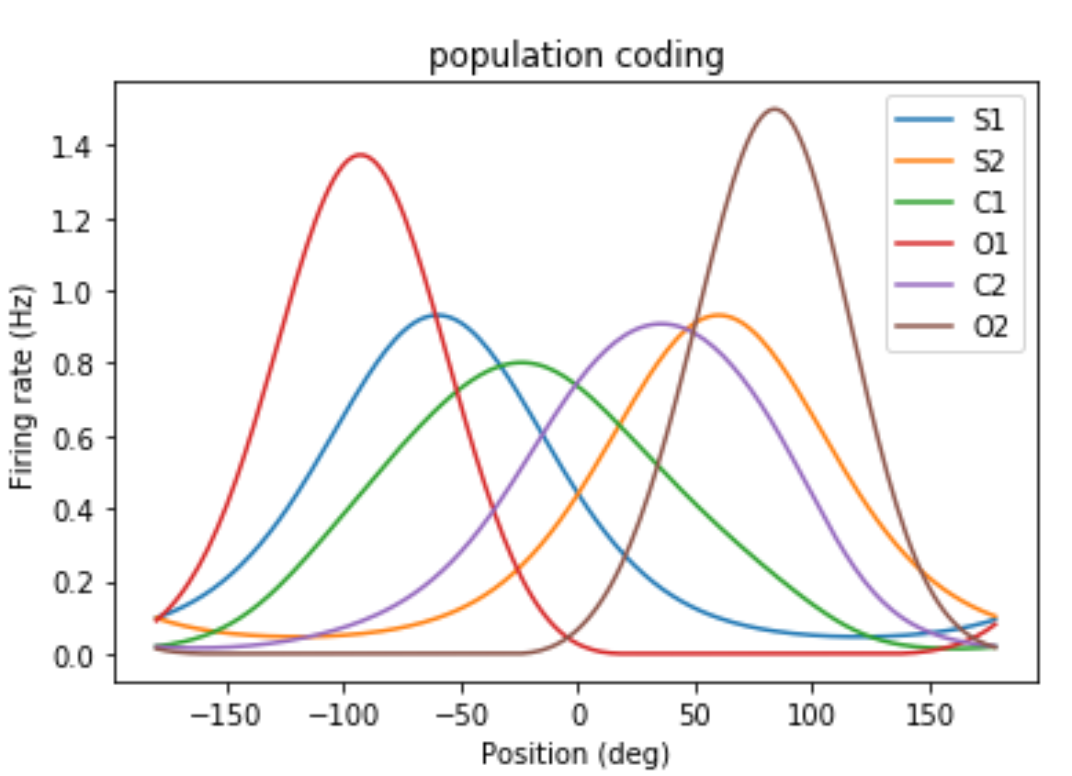
Results: population response
S1 only:
S2 only:
Both S1 and S2:
Both S1 and S2:

Slide 10
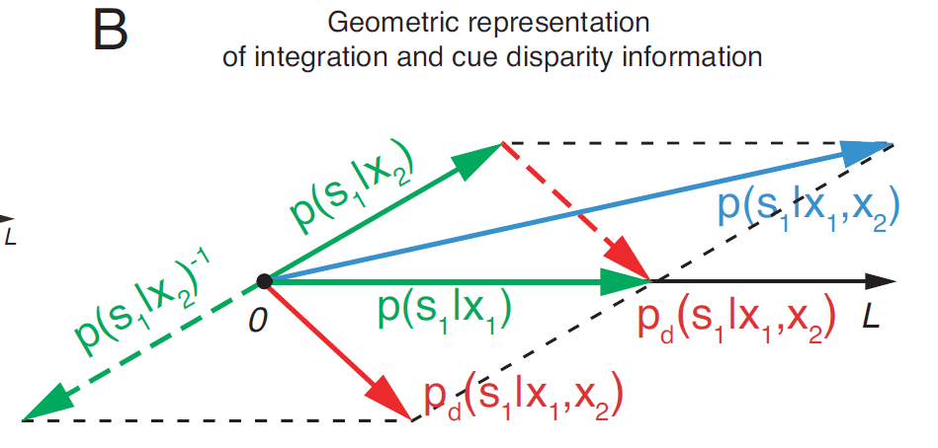
Optimal integration
We can formulate the multisensory processing problem as probabilistic inference
This gives a quantitative evaluation of our model

Slide 11
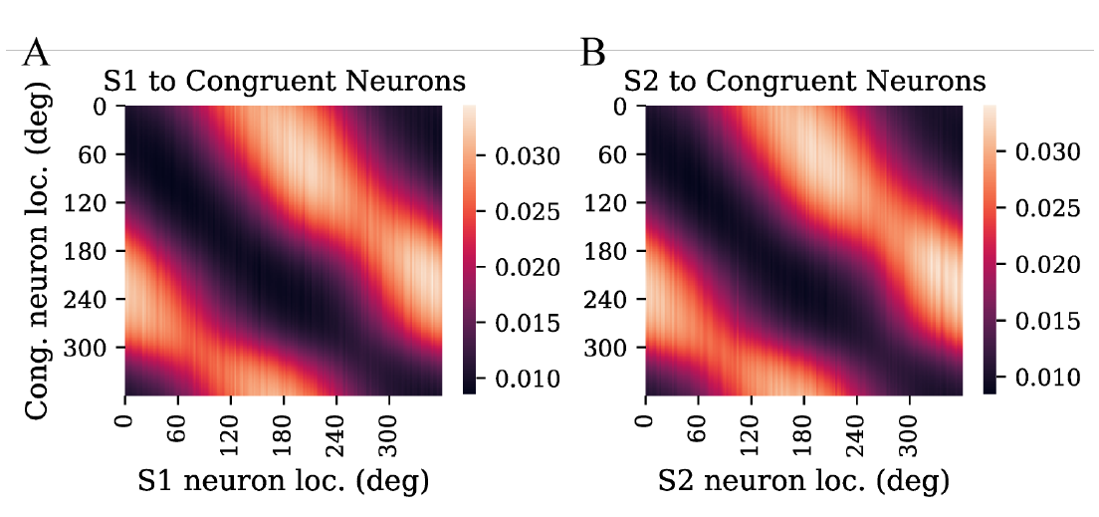
Side notes
Topographical organization
Noise
Persistent activity
…

Slide 12
Future work
Model selection unit (trained by unsupervised learning)
M
C1
C2
O1
O2
S1
S2
Stimulus 1
Stimulus 2

